Slide 1
Fly IQ - Jet Sync

Slide 2
Information
Project: Jet Sync App (by FlyIQ)
Environment: Visual Studio 2022, SQL server 2019, Entity Framework
Technology: Asp .net using C#, MVC Core 6.0, Restful API, selenium
Domain: Education
Duration: July 2024 - Jan 2025

Slide 3
Introduction of JetSync Admin Panel (Development)
The JetSync Admin Panel, part of the FlyIQ platform, streamlines management of private flight requests and operator participation. It enables admins to monitor real-time flight demand, manage users and subscriptions, and compare client needs with operator availability. Integrated with NBAA, FlyInsight, and OpenAI APIs, it automates data processing and enhances decision-making, serving as a secure, intelligent hub connecting clients and operators within the FlyIQ ecosystem.

Slide 4
Problem Statement
JetSync required a powerful backend system to manage flight requests (“NEED” data), onboard operators, and sync data from external aviation sources. However, there were key challenges:
No centralized place for administrators to monitor or manage user-submitted flight needs.
Operators needed a secure and structured way to join and manage their availability.
External data from sources like NBAA and FlyInsight came in raw, unformatted structures, making it difficult to process.
Comparing client needs with operator availability was manual and error-prone.
Sensitive calendar URLs and user data needed protection through encryption.

Slide 5
Affected Areas
The problems identified affected several areas:
Data Management: Flight request (NEED) data was coming from both internal forms and external APIs with inconsistent formats.
Admin Workflow: Admins had no efficient tools for reviewing and comparing flight needs vs. operator calendars.
User Onboarding: New operator sign-ups and credential generation lacked structure.
Security: Security
Data Formatting: Scraped data from NBAA via Selenium was unstructured and unreadable in its raw form.
Fragmented data governance processes (ROPA, breach logs, DPIAs, LIAs)
Limited collaboration: employees couldn’t report incidents easily
UI lacked consistency across modules and devices.
Administrative overhead with manual spreadsheet tracking and double data entry.

Slide 6
Solution
To address these issues, the following solutions were implemented:
Built a robust admin panel to display all flight needs and manage user data.
Developed a super admin module with full control over users, needs, and platform settings.
Integrated FlyInsight calendar to track operator availability.
Pulled flight request data from NBAA and displayed it alongside internal submissions.
Built a comparison engine to match client-submitted flight needs with available operator calendars.
Secured external calendar URLs using data encryption techniques.
Used OpenAI API to process and clean raw scraped data from NBAA for better readability and accurate admin review.

Slide 7
How We Implemented
Website & Platform Integration: Connected JetSync with the FlyIQ website and enabled user subscriptions.
Admin Panel: Created dashboards showing flight needs, operator details, and subscription statuses. Allowed user onboarding by generating login credentials.
Super Admin Module: Added capabilities to view all system data, override records, and manage other admins.
Calendar Integration: Pulled availability data from FlyInsight calendar into the admin dashboard. Stored and updated it regularly in the backend.
NEED Data Handling: Pulled client needs from FlyIQ and external needs from NBAA via Selenium.
OpenAI Integration: Processed unstructured NBAA data using OpenAI’s API. Converted it into structured formats like: Departure: KMIA, Arrival: KJFK, Pax: 3.
Data Comparison Engine: Compared client needs with operator calendars and flagged matches/conflicts.
Security: Encrypted FlyInsight URLs and applied form validation throughout.

Slide 8
Outcome
A fully functional admin panel was delivered with real-time access to flight requests and operator availability, enabling efficient operations. Super Admin controls improved system oversight, while OpenAI API integration automated data handling and reduced errors. Enhanced security and streamlined workflows made JetSync a powerful tool for managing private aviation requests.

Slide 9
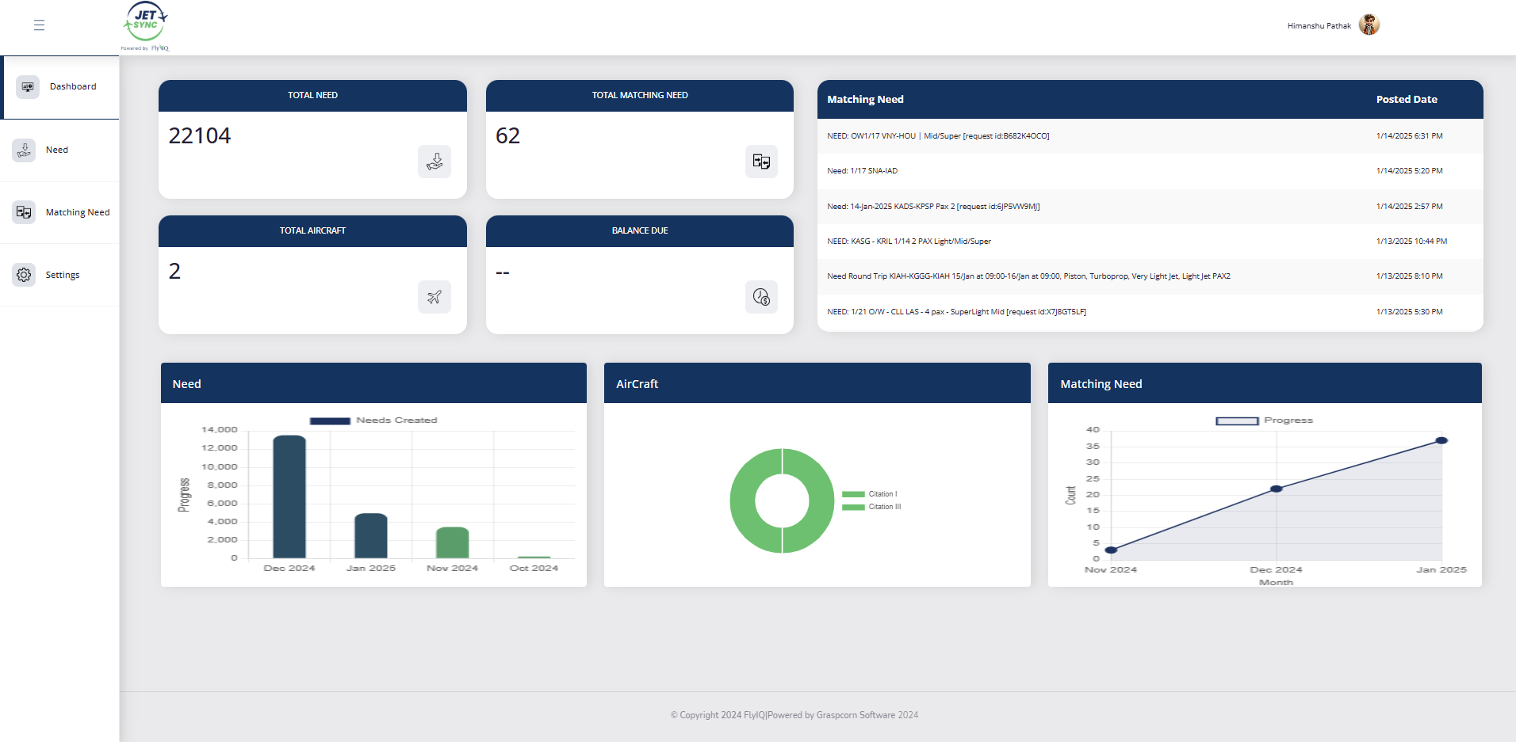

Slide 10
